Slide 1
Age of Exploration: Explorers

Slide 2
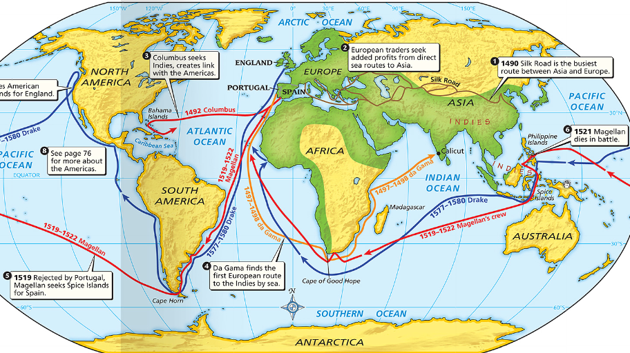
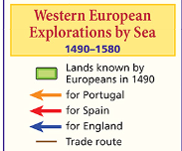
The Age of Exploration
Who were the explorers, where did they go, & how did they change world history?

Slide 3
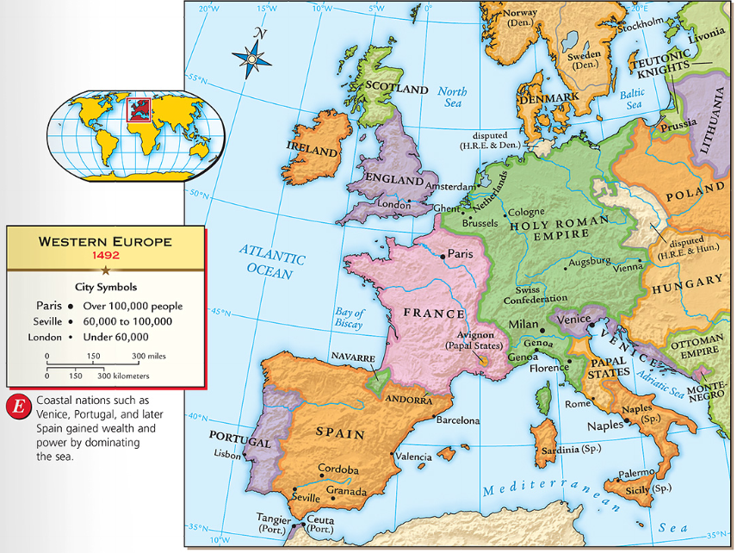
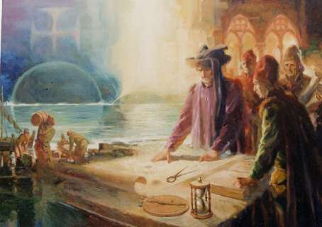
Portugal was the early leader in the Age of Exploration
In Portugal, Prince Henry the Navigator started a school of navigation to train sailors
He brought in Europe’s best map-makers, ship-builders, & sailing instructors
He wanted to discover new territories, find a quick trade route to Asia, & expand Portugal’s power

Slide 4
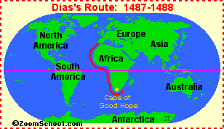
Bartholomeu Dias (1487)
Came From: Portugal Worked For: Portugal He led the first expedition to sail around Africa’s Cape of Good Hope to get to India. Dias did NOT go any further and returned to Portugal.

Slide 5
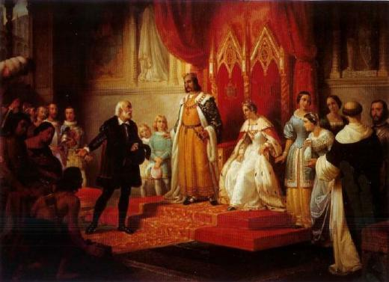
The Spanish government saw Portugal’s wealth & did not want to be left out
More than any other European monarch, Ferdinand & Isabella of Spain sponsored & supported overseas expeditions (Crusader Zeal & need for wealth/power)

Slide 6
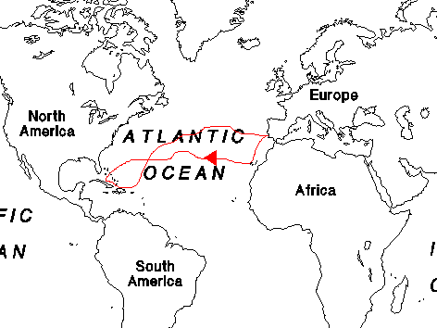
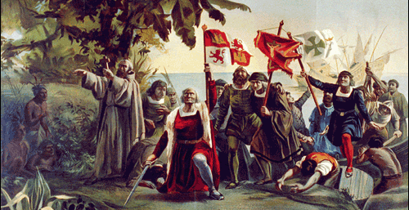
Like most educated men of the Renaissance, Columbus believed the world was round & thought he could reach Asia by sailing west. He was just wrong about the size of the world!
Columbus reached the Bahamas in America but thought that he had reached islands off the coast of India (Indonesia, etc.)
He made 4 trips to “India” never knowing he was in “America”

Slide 7
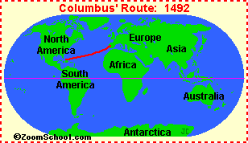
Christopher Columbus (1492)
Came From: Italy Worked For: Spain He sailed west across the Atlantic Ocean in 1492, hoping to find a route to the Indies.

Slide 8
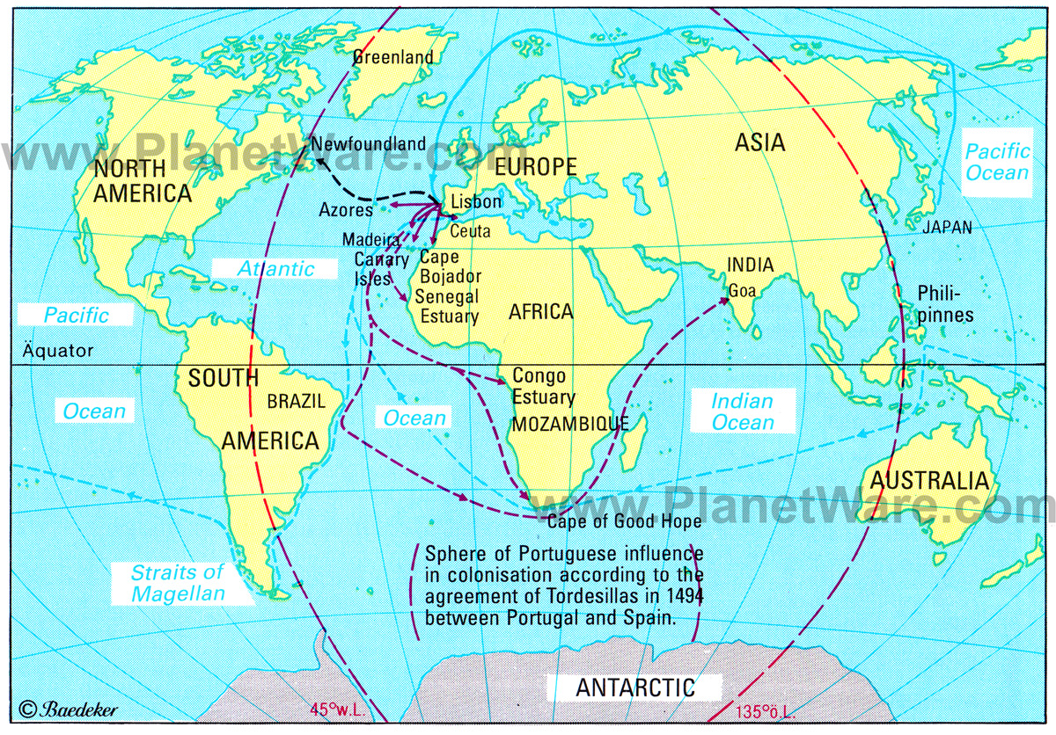
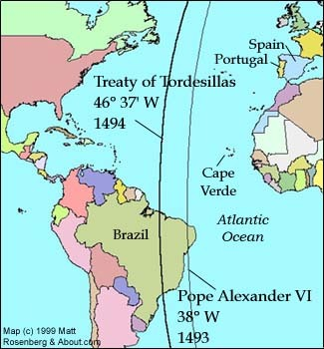
Treaty of Tordesillas (1494)
A line that was agreed upon by the Spanish and Portuguese to clear up any confusion on the newly claimed land in the New World.
Spain had control of territories to the West, Portugal had territories to the East.
Notes:
The Treaty of Tordesillas was agreed upon by the Spanish and the Portuguese to clear up confusion on newly claimed land in the New World.
In order make trade more efficient, Portugal attempted to find a direct water route to the India and China. By using a direct water route, Arab merchants, who owned land trade routes, were not able to make a profit off of the European trade merchants. After Columbus discovered the New World in 1492, it was clear that conflict would soon arise over land claims by Spain and Portugal. The Portuguese also wanted to protect their monopoly on the trade route to Africa and felt threatened. It was only after the realization that Columbus had found something big that land became the important issue. The newly discovered land held great potential wealth which would benefit European nations.

Slide 9
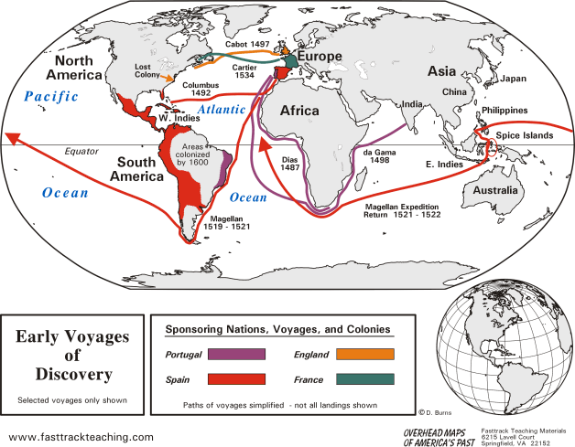
Portugal has to stay to the East due to the Treaty. They focus on going around Africa to get to India creating trading colonies along their route: African coast, in Brazil, & the Spice Islands in Asia. They forced others to pay them a tax to be able to trade.

Slide 10
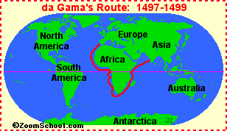
Vasco da Gama (1497)
Came From: Portugal Worked For: Portugal He discovered an ocean route from Portugal to India around the Cape of Good Hope (Africa).

Slide 11
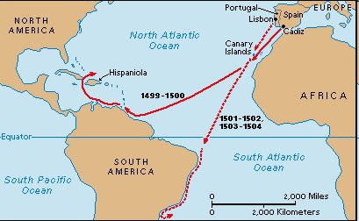
Amerigo Vespucci (1500)
Came From: Italy Worked For: Portugal One of the first explorers to recognize that the places he visited were not part of Asia, but rather a “New World”.

Slide 12
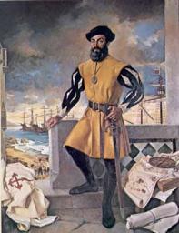
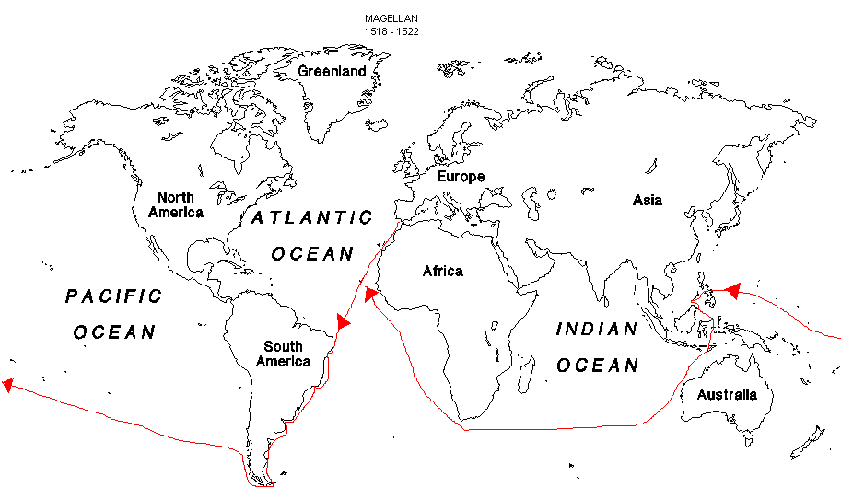
Despite the fact that Columbus never found Asia, and “Amerigo” recognized this was a “New World” Spanish explorers continue to try to reach Asia by sailing West
Magellan is one such explorer.

Slide 13
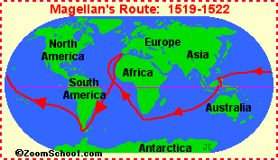
Ferdinand Magellan
Came From: Spain Worked For: Spain Led the first European expedition to circumnavigate the globe. However, Magellan was killed during the voyage in the Philippines.

Slide 14
Spain creates colonies in North & South America focused on increased wealth and conversions to Christianity (Crusader Zeal)

Slide 15
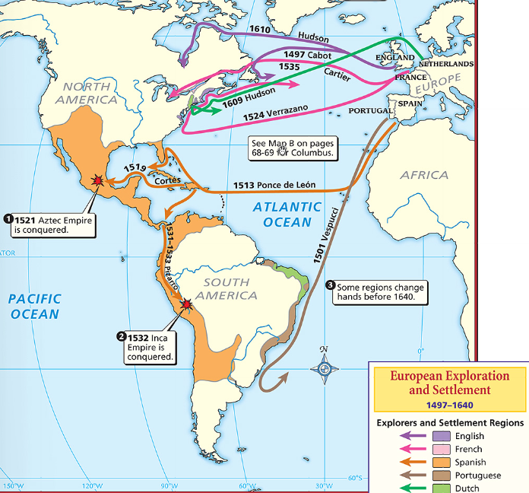
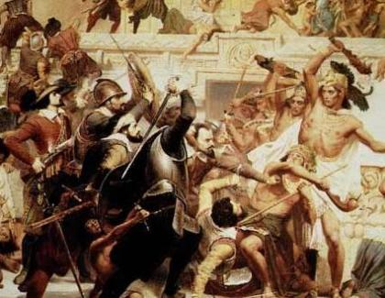
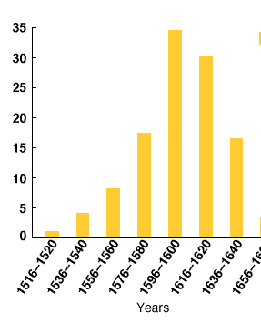
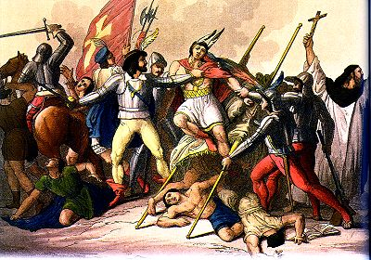
Spain sent explorers called conquistadors to the New World to find gold, claim land, & spread Christianity
Cortez conquered the Aztecs
Pizarro conquered the Inca
The influx of gold from America made Spain the most powerful country in Europe during the early years of the Age of Exploration
Notes:
Spain sent explorers to the New World to find gold, claim land, & spread Christianity
Cortez conquered Mexico & destroyed the Aztec civilization
Pizarro conquered Peru & destroyed the Incan civilization

Slide 16
England, France, & the Netherlands became involved in overseas exploration & colonization as well

Slide 17
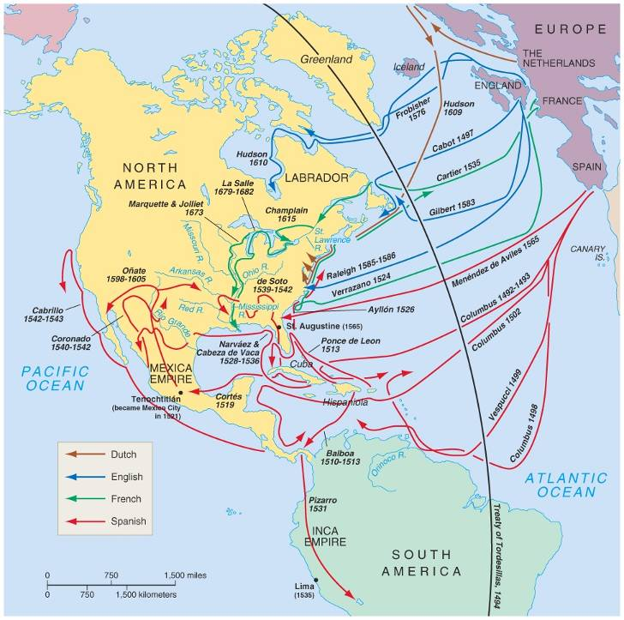
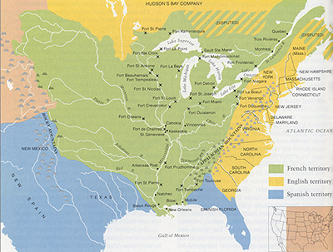
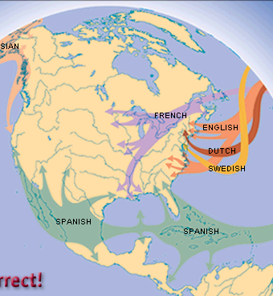
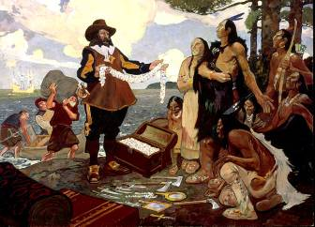
After failing to do so, Champlain founded the French colony of Quebec
The French explorer Samuel de Champlain searched Canada for a northwest passage to Asia
The French would soon carve out a large colony along the Mississippi River from Canada to New Orleans

Slide 18
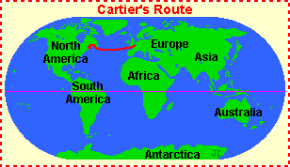
Jacques Cartier
Came From: France Worked For: France French explorer who led three expeditions to Canada in 1535.

Slide 19
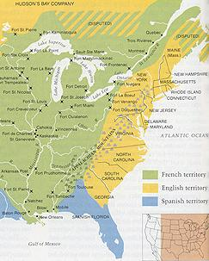
Unlike other European nations whose kings paid for colonies, the English colonies were paid for by citizens who formed joint-stock companies
English colonies formed along the Atlantic Coast of North America by colonists motivated either by religion or wealth

Slide 20
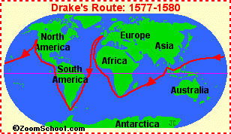
Sir Francis Drake
Came From: England Worked For: England British Explorer who led second expedition to circumnavigate the globe. He lived through the trip! Drake also led the English fleet when Britain defeated the Spanish Armada in 1588 for Queen Elizabeth.

Slide 21
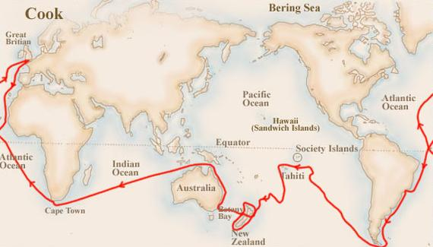
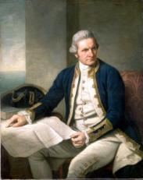
The English explorer James Cook was the first European to make contact with Australia, New Zealand, & Hawaii

Slide 22
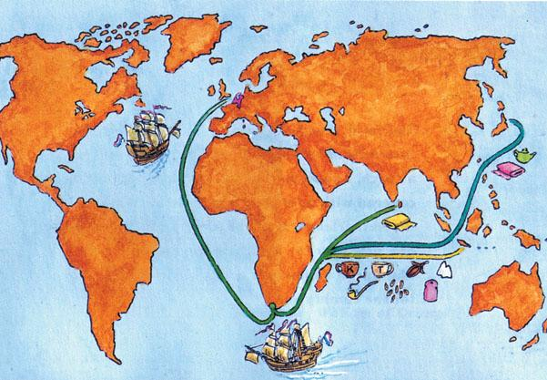
Like England, the Netherlands allowed private companies to
fund exploration
The Dutch had colonies in America & Africa, but the Dutch East India Company dominated trade in Asia

Slide 23
Which explorer do you think had the greatest impact? Why?

